Slide 1

Notes:
http://www.youtube.com/watch?v=yN9_WT9l7xo

Slide 3
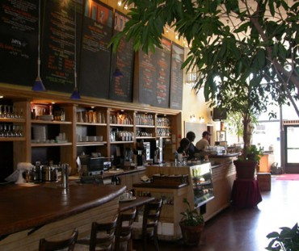
Our COFFEE,
Our PARTNERS,
Our CUSTOMERS,
Our STORES,
Our NEIGHBORS & Our SHAREHOLDERS
Mission: “To inspire and nurture the human spirit – one person, one cup and one neighborhood at a time” (Starbucks.com).

Slide 4
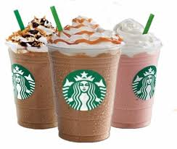

Slide 5
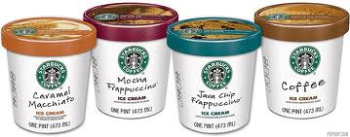

Slide 6
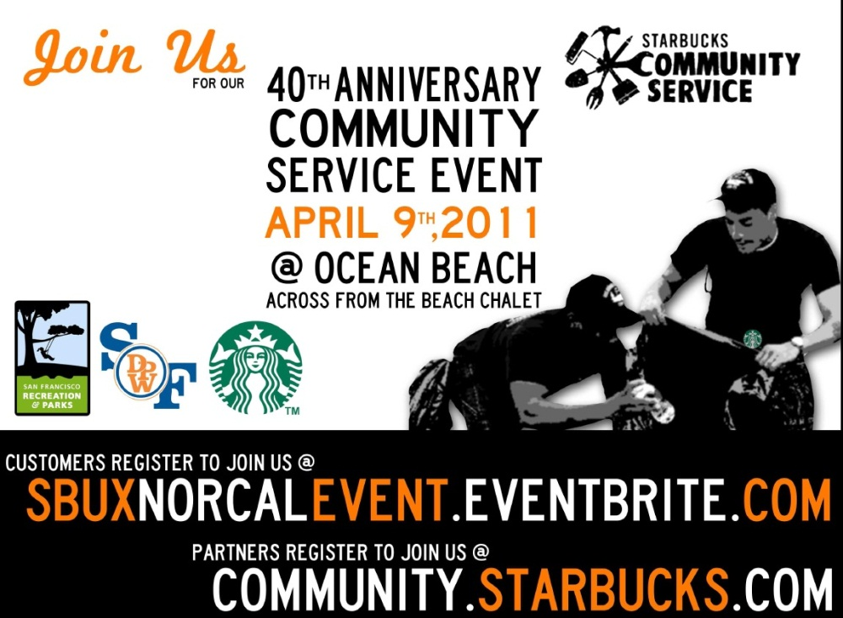
Community Service,
Youth Action,
Starbucks (RED) &
The Ethos Water Fund
“We’ve always believed that businesses can – and should – have a positive impact on the communities they serve. “

Slide 7
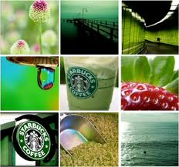
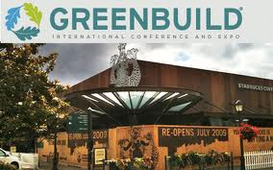
Recycling, Energy, Water,
Green Building & Climate Change
Ethical Sourcing:
Farmer Support
Wellness: Health Care Reform, Menu Labeling & Sodium Reductions
Notes:
http://www.youtube.com/watch?v=9hapVwQrL38&feature=related

Slide 8
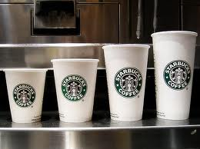
External Environment – Natural and Societal
Natural Environment
  Growing water scarcity
  Energy availability a growing problem
  Increased focus on sustainability
  Growing recycling focus
Societal Environment
  Economic
  Technological
    > 3 million payments by phone since the launch of the mobile app
    1.3 million followers on Twitter
    4.5 million Foursquare check-ins
    20 million fans on Facebook
  Political/Legal

Slide 9



Slide 10
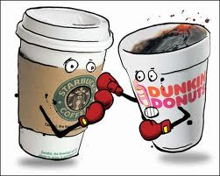
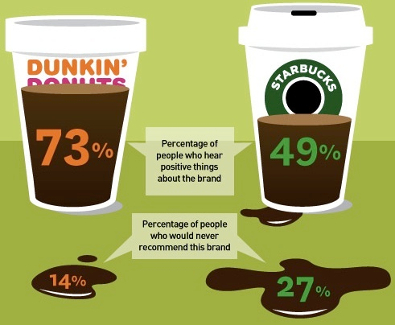
Porter’s Five Forces:
Current Competitive Force
Threat of Potential Entrants
Bargaining Power of Buyers
Bargaining Power of Suppliers
Threat of Substitute Products
“Starbucks is always managing the tension between opposites. One the other hand, I’d say we’re comforting and predictable. Yet on the other hand, we’re constantly surprising and delighting.”

Slide 11
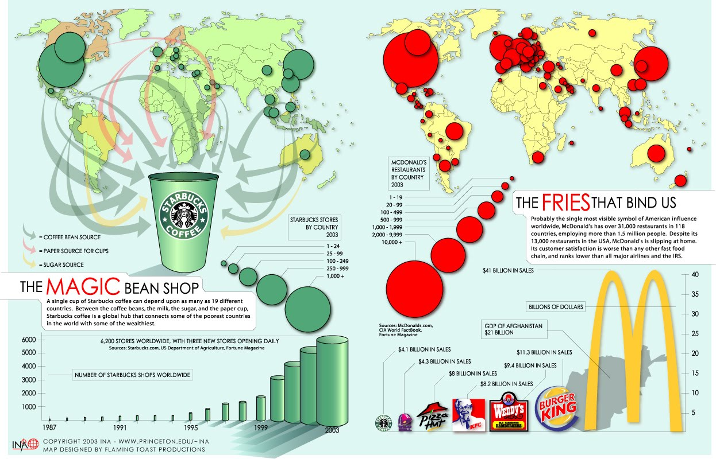

Slide 12
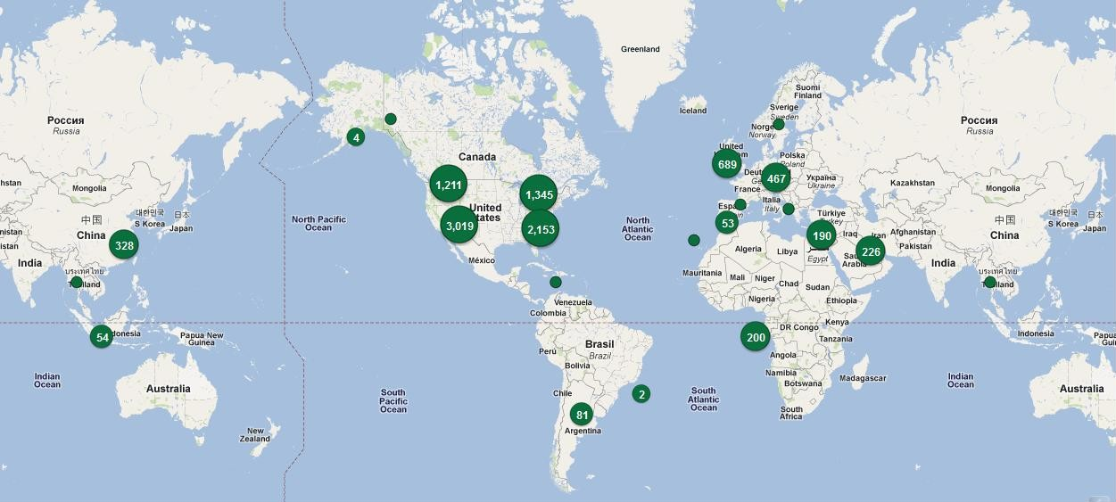
Starbucks Coffee Worldwide Locations

Slide 13
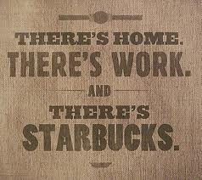
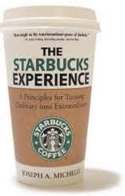

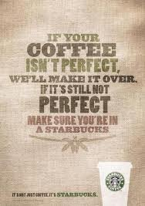
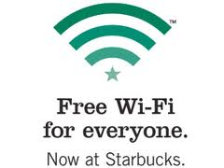
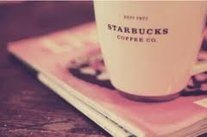
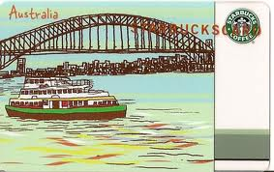
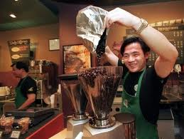
“We believed the best way to meet and exceed the expectations of our customers was to hire and train great people, we invested in employees who were zealous about good coffee.”
Notes:
http://www.youtube.com/user/Starbucks#p/c/4DD39D3B9D8389D3/5/67Dk8jdVIa8

Slide 14
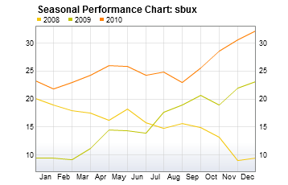
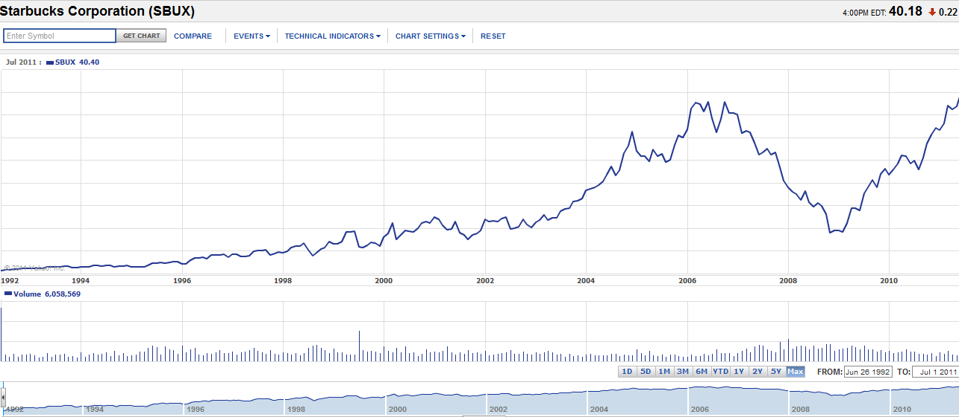
STARBUCKS FINANCIALS
Notes:
Finance – stock chart, competitive chart

Slide 15


Slide 17
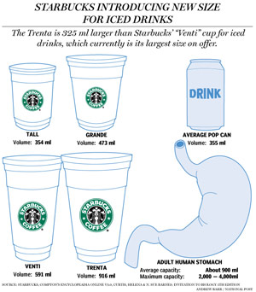

Slide 18

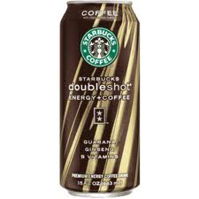
STRENGHTS
Social Responsibility
Social Media
‘Third Place”
WEAKNESSES
Brand Dilution
Market Saturation
High Operating Expenses
OPPORTUNITIES
Increase Consumer Means Increased Store Locations
Unique Store Locations
Customer Are Not Price Sensitive
THREATS
Competitors Offering Similar Products
Starbucks Effect
Change in Societal Expectations
Notes:
http://www.starbucks.com/responsibility/community/starbucks-foundation

Slide 19

Reevaluate store locations to consider less populated and affluent areas
Focus less on increasing output and locations and more on quality on brand image
To continue operating in a non-franchise manner
Release new products and services that are more unique/innovative than their competitors
Maintain long-term contracts with suppliers
Expand globally in a more timely manner

Slide 20
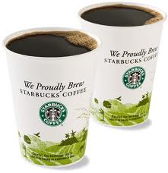
Any questions?

